Slide 1
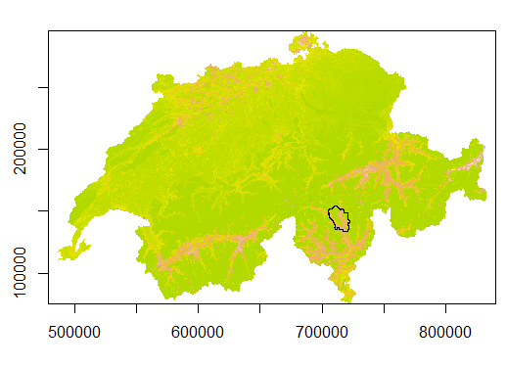
Sub catchment selection - Ticino

Slide 2
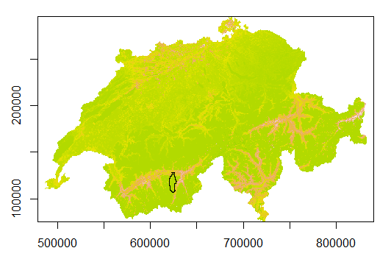
Sub catchment selection - Valais

Slide 3

Sub catchment selection - Zurich

Slide 4
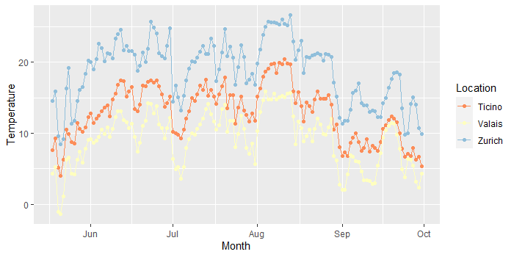
Daily mean temperature in three cantons

Slide 5
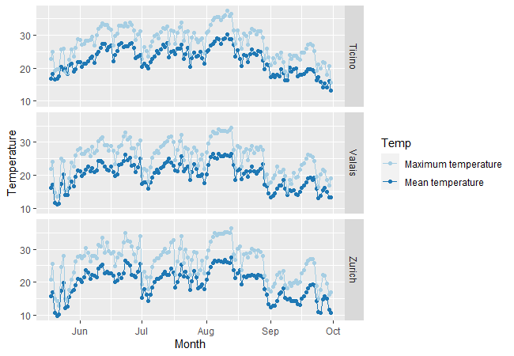
Daily temperature in three cantons (Max and Mean)

Slide 6
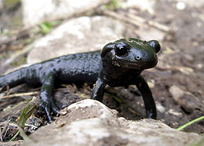
Species selection (Amphibians)
Alpine salamander - Salamandra atra
Upper thermal limit – 34.3 ℃

Slide 7
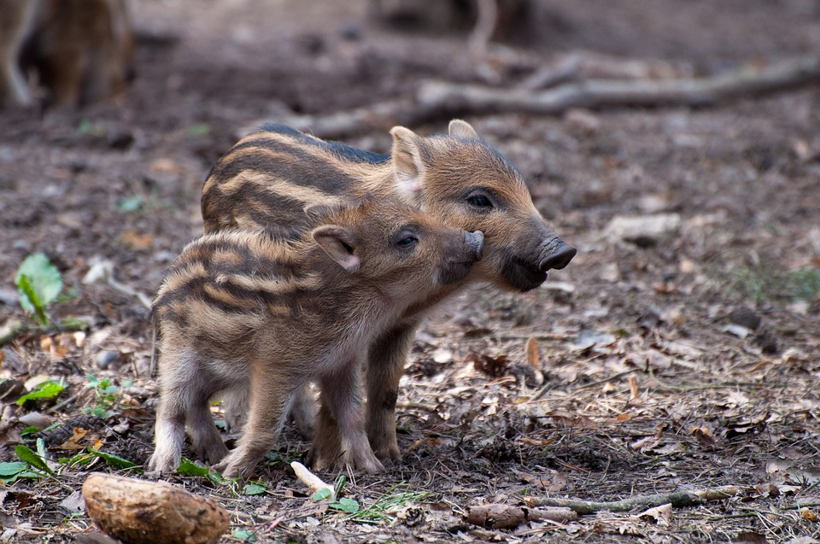
Species selection (large mammals)
Wild boar – Sus scrofa
Upper thermal limit – 22 ℃

Slide 8
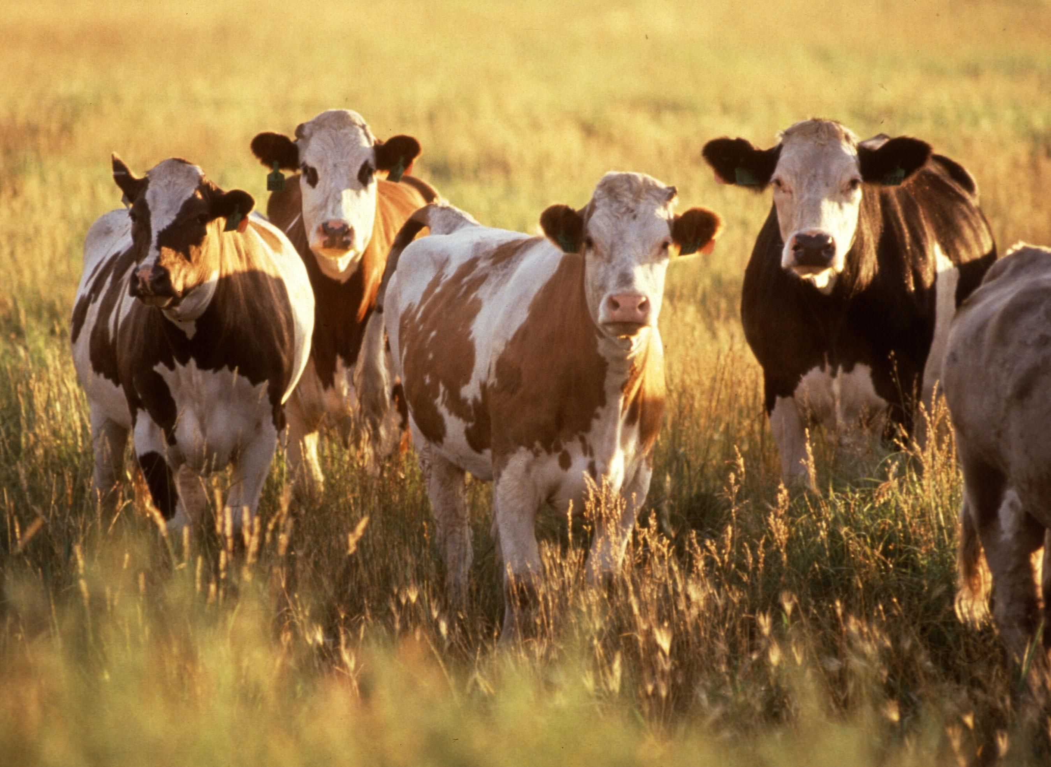
Species selection (Cattle)
THI Value
Mild 72-78
Moderate 79-88
Severe 89-98

Slide 9
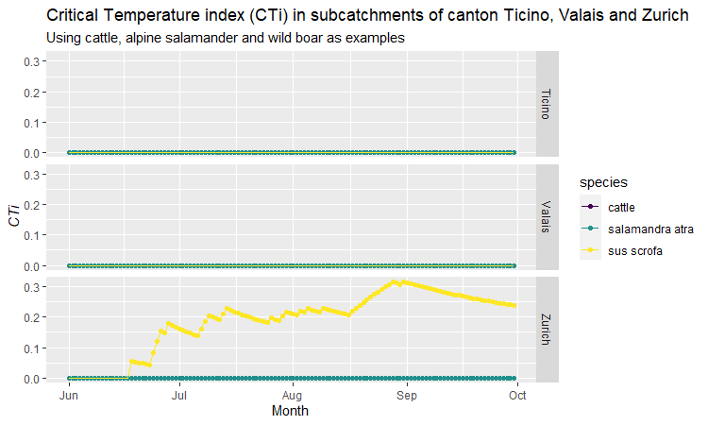
Critical Temperature index

Slide 10
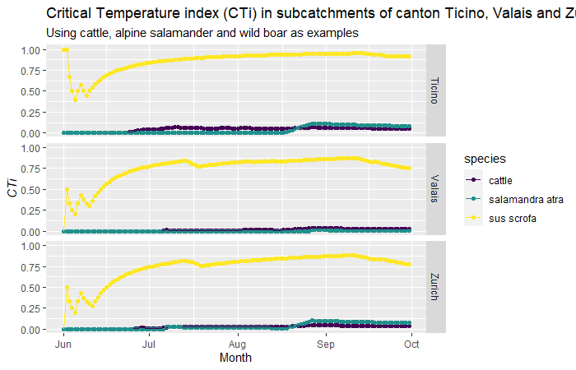
Critical Temperature index (with maximum temperature)

Slide 11

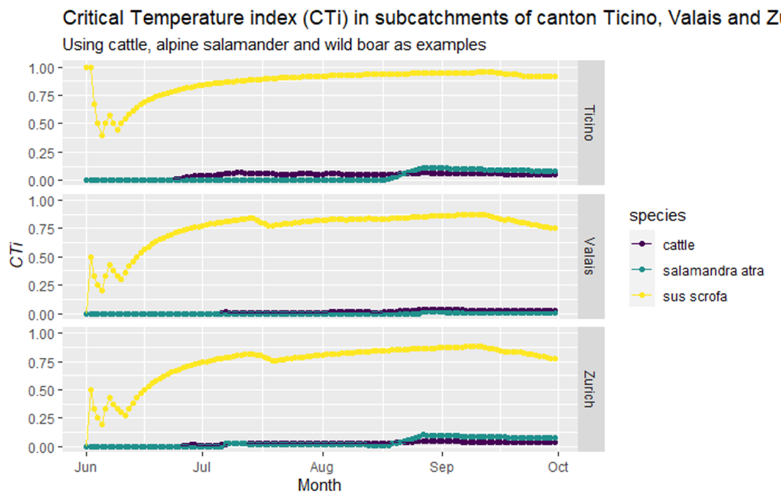


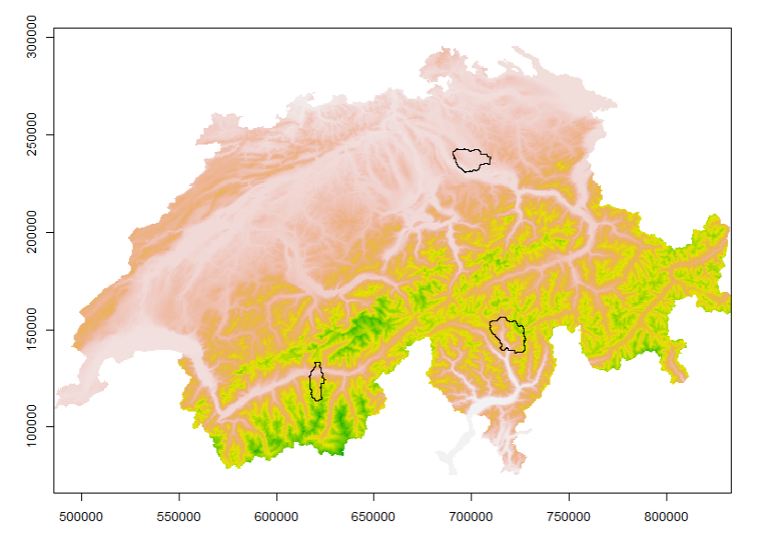

Slide 12
